Slide 1
Managing the data pull
Brian Caffo, Jeff Leek, Roger Peng
@bcaffo
www.bcaffo.com

Slide 2

Managing the data pull - MESSY DATA
http://www.mlplatform.nl/wp-content/uploads/2013/02/big-numbers1-500x198.jpg

Slide 3
Managing the data pull
Almost every data analysis requires at least one of:
pulling data from a larger more complex data source
merging disparate sorts of data
summarizing complex data types (text, speech, images)
going from a from a format that is convenient for one purpose to one convenient for analysis (archival -> analytic for example)

Slide 4
Managing the data pull
Almost every data analysis requires at least one of:
pulling data from a larger more complex data source
merging disparate sorts of data
summarizing complex data types (text, speech, images)
going from a from a format that is convenient for one purpose to one convenient for analysis (archival -> analytic for example)
As a manager, you likely won’t be performing these operations. How do you help manage this process?
Lots of resources to help practitioners, fewer resources for managing the practitioners
This lecture gives some simple steps for managers

Slide 5

Table 1
Summary tables are a great way to catch errors
In Epi and Biostat the first table summarizing variables is called “Table 1”
Requiring the regular creation of basic summary tables is a great way to catch errors
Get standard deviations along with means, medians and quantiles!
Check your units!
Compare across reports
http://www.condenaststore.com/-sp/I-attribute-it-to-human-error-But-then-I-attribute-everything-to-human-e-New-Yorker-Cartoon-Prints_i8642395_.htm

Slide 6
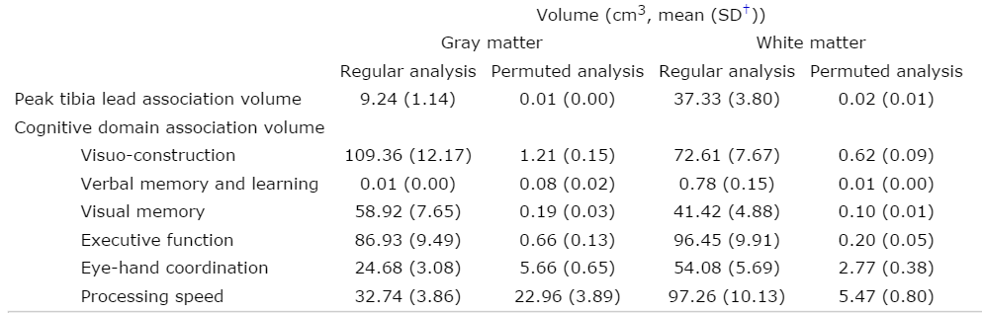
Example
http://aje.oxfordjournals.org/content/167/4/429/T1.expansion.html

Slide 7
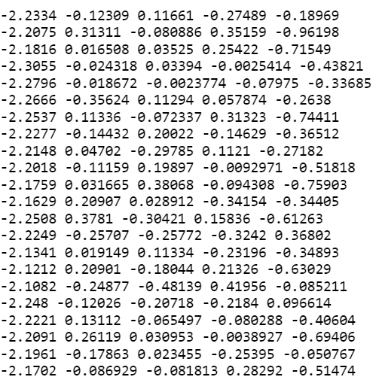
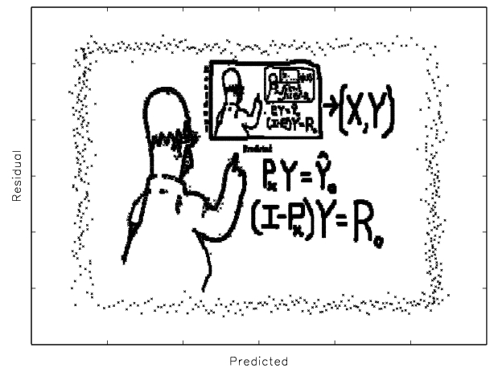
Regression diagnostics
http://www4.stat.ncsu.edu/~stefanski/NSF_Supported/Hidden_Images/stat_res_plots.html

Slide 8
Some things to look at
Residual - the difference between the response and the fitted value; residual plots shouldn’t have systematic patterns
Hat values - consider how variable a data row is among the space of predictors
DF fits, DF betas, Cook’s distance - how much do fitted values and coefficients change when a point is not included in the fit?
PRESS residuals, leave one out residuals - how much do predictions change when a point is left out of an analysis

Slide 9
Benford’s law (from Wikipedia)
Benford's law, also called the First-Digit Law, is a phenomenological law about the frequency distribution of leading digits in many (but not all) real-life sets of numerical data.
https://en.wikipedia.org/wiki/Benford%27s_law

Slide 10
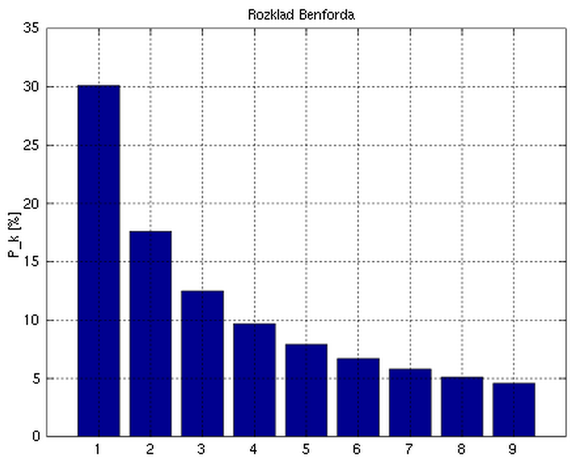
Try it out
"Benford-physical" by Drnathanfurious at en.wikipedia - Transferred from en.wikipedia to Commons by User:Tam0031 using CommonsHelper.. Licensed under Public Domain via Commons - https://commons.wikimedia.org/wiki/File:Benford-physical.svg#/media/File:Benford-physical.svg

Slide 11

DQQs
You can’t check every data point
However, you can query and check some
Use statistical sampling logic to estimate the proportion of bad data in your sample

